Slide 1
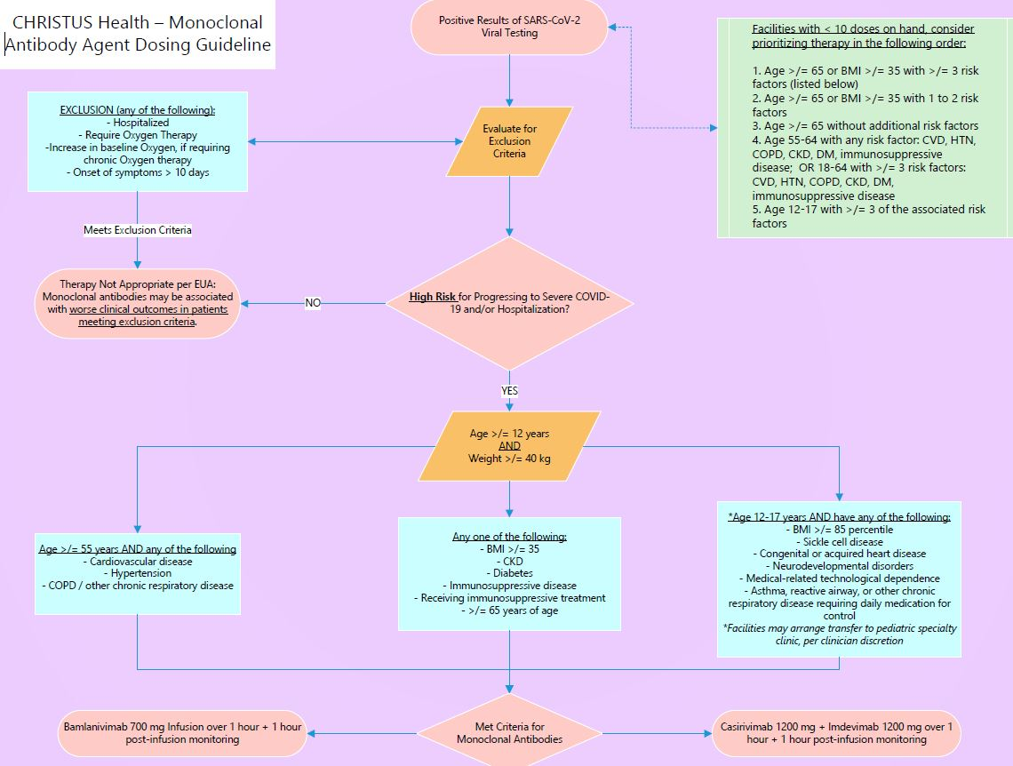
Monoclonal AB Update – Bamlanivimab/Casirivimab

